Slide 1
An Adaptive Memory-Based Reinforcement Learning Controller
By Keith August Cissell

Slide 2
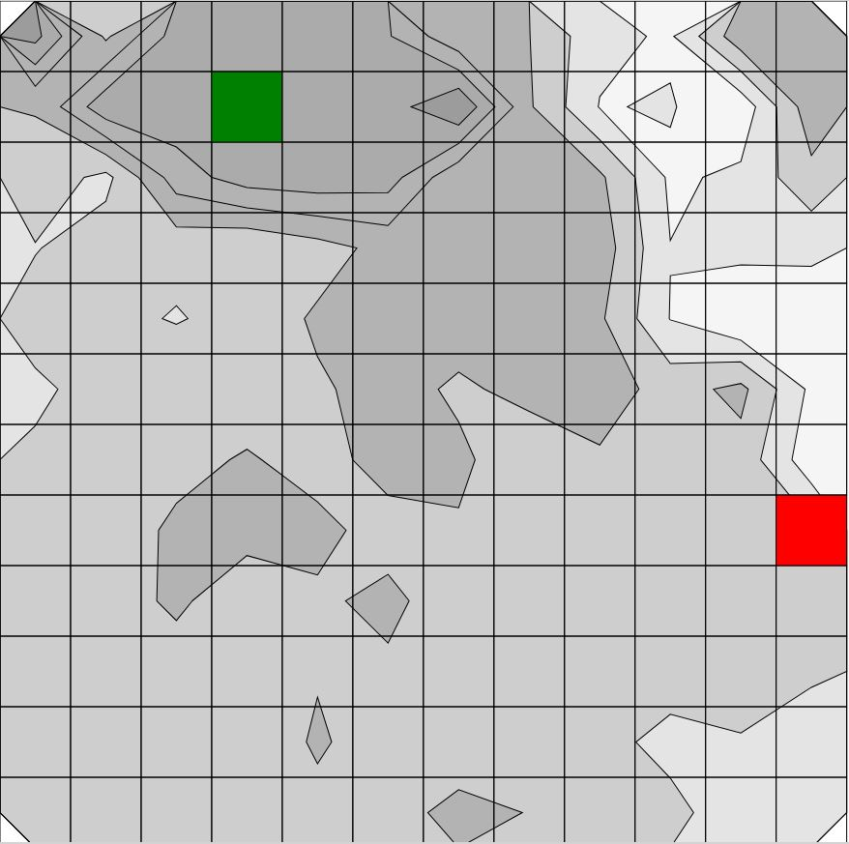
Overview
Agent
Environment
Goal

Slide 3
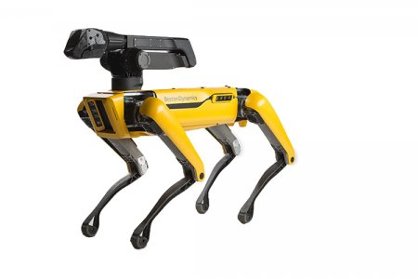
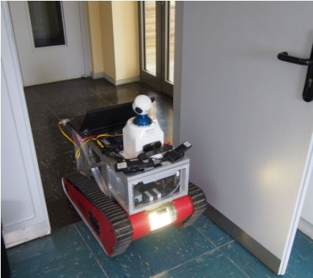
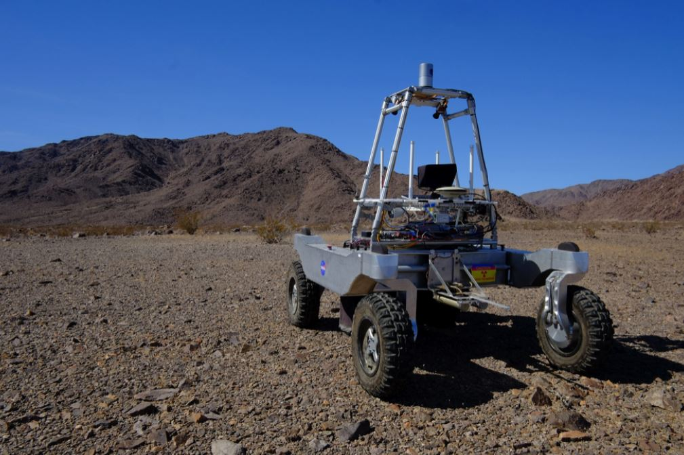
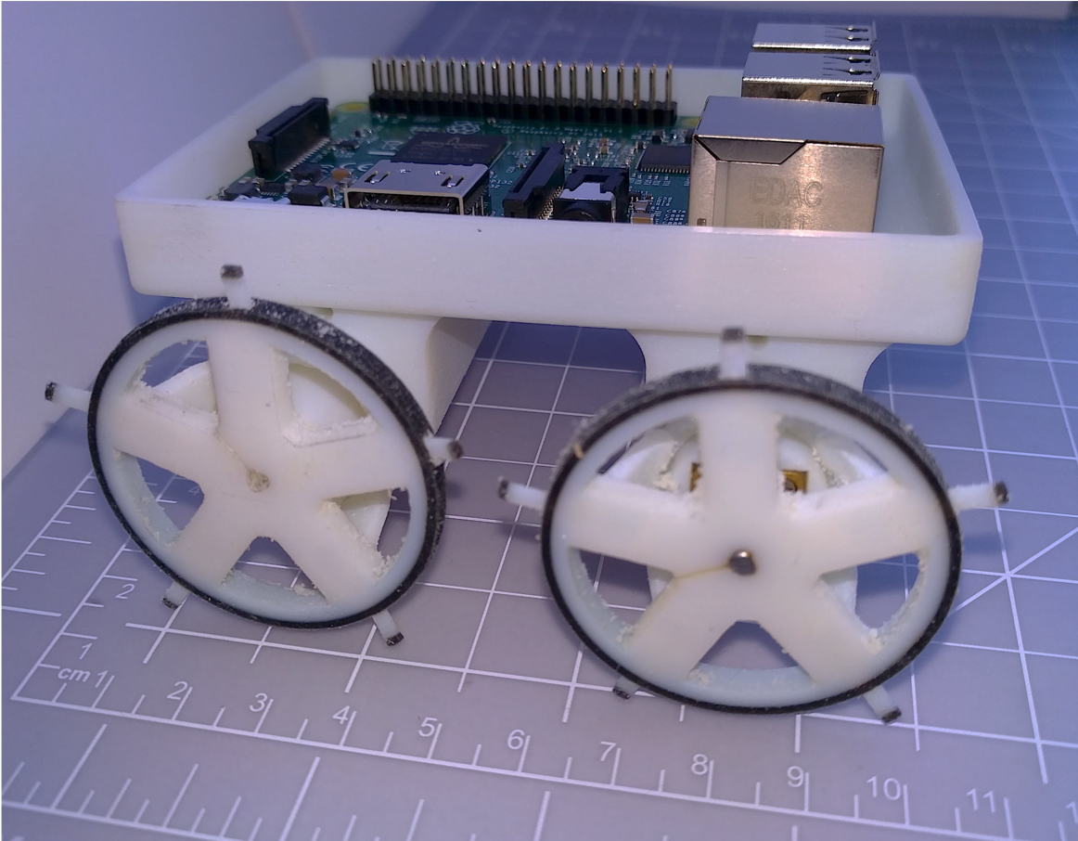
Autonomous Robotics
Growing field due to recent technological advances
Hardware capabilities
Computationally intelligent systems
Applicable to a variety of use cases
© 2018 Boston Dynamics
© 2015 Perea Stroma et al.
© 2018 Arora et al.
© 2018 Clark et al.

Slide 4
Exploration
Unknown environment
Potential hazards
Examples:
Search and rescue
Tornado
Resource discovery
Measuring geological properties for mining

Slide 5
Motivation
Wide variety of use cases
Different tasks
Different hardware components
Different control schemas
Autonomous robots typically built from scratch
Time
Resources

Slide 6
Thesis
Surveillance Coordination and Operation Utility (SCOUt)
Finding a unified solution to exploration-based operations
Abstracting exploration processes
Generalizing agent knowledge and behaviors

Slide 7
SCOUt Platform
Simulation
Procedurally generate environments
Agent setup
Goal definition
Controller
Memory-based reinforcement learning
Action reward prediction

Slide 8
Related Work
Partially observable Marcov decision process (POMDP)
Based on agent’s “state”
Predictive action decision model
Through the use of memory
Reinforcement learning (RL)
Agent actions receive “rewards”
Memory of past action rewards

Slide 9
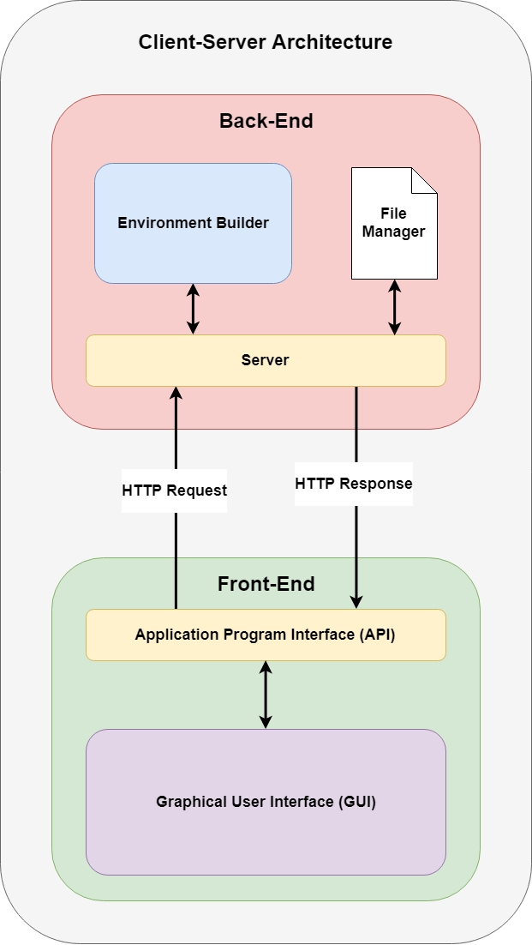
SCOUt Framework
3
Back-End
Scala data structures
Simulation
Front-End
Electron Application
Configure Environments
Visualize
Communication
HTTP
JSON
2
4
1
5

Slide 10
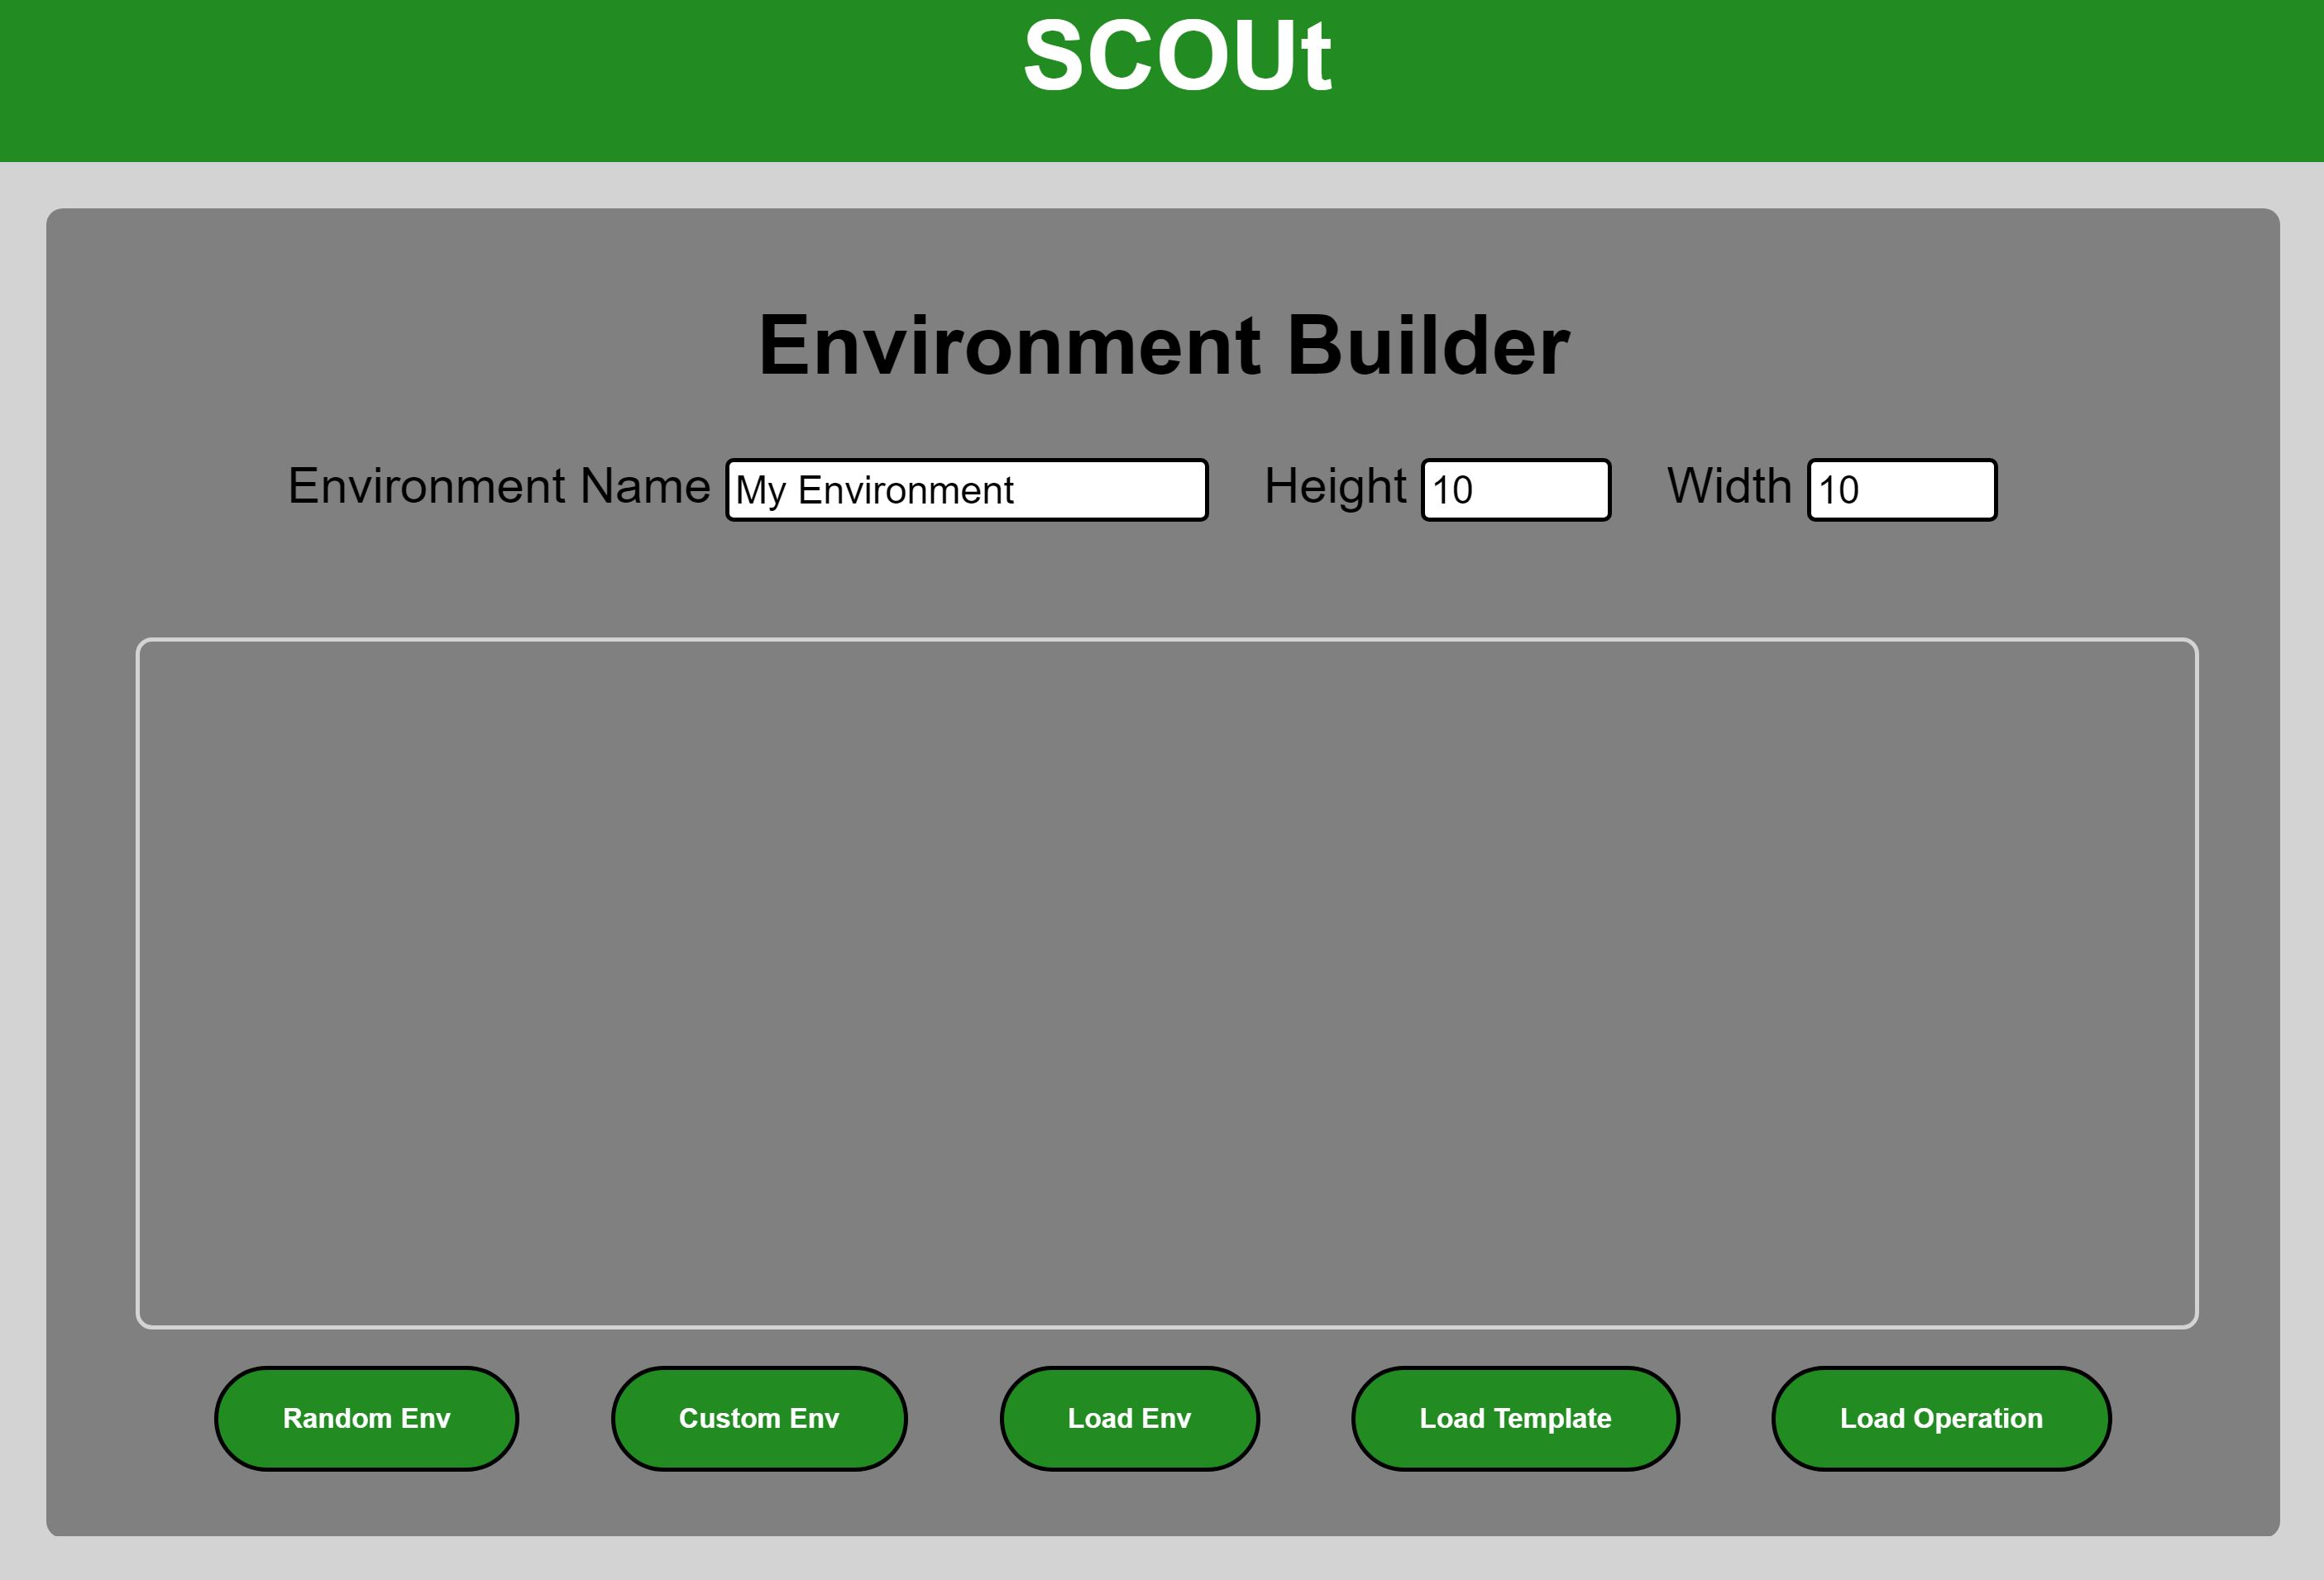
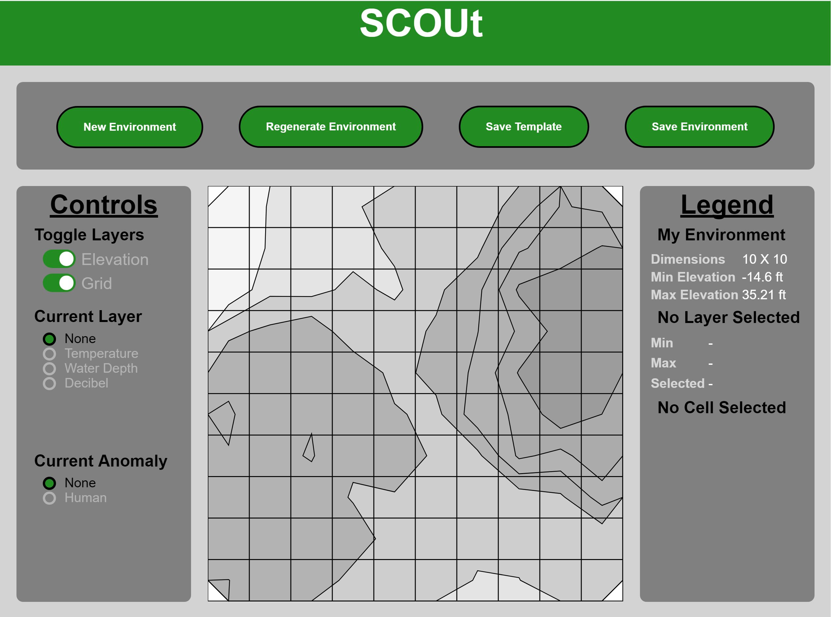
Front-End

Slide 11
simulation
Environments
Diverse and unique
Agents
Abilities
Response to environment
Goals
Measurable level of completion
Notes:
In order to test the controllers in a variety of scenarios…

Slide 12
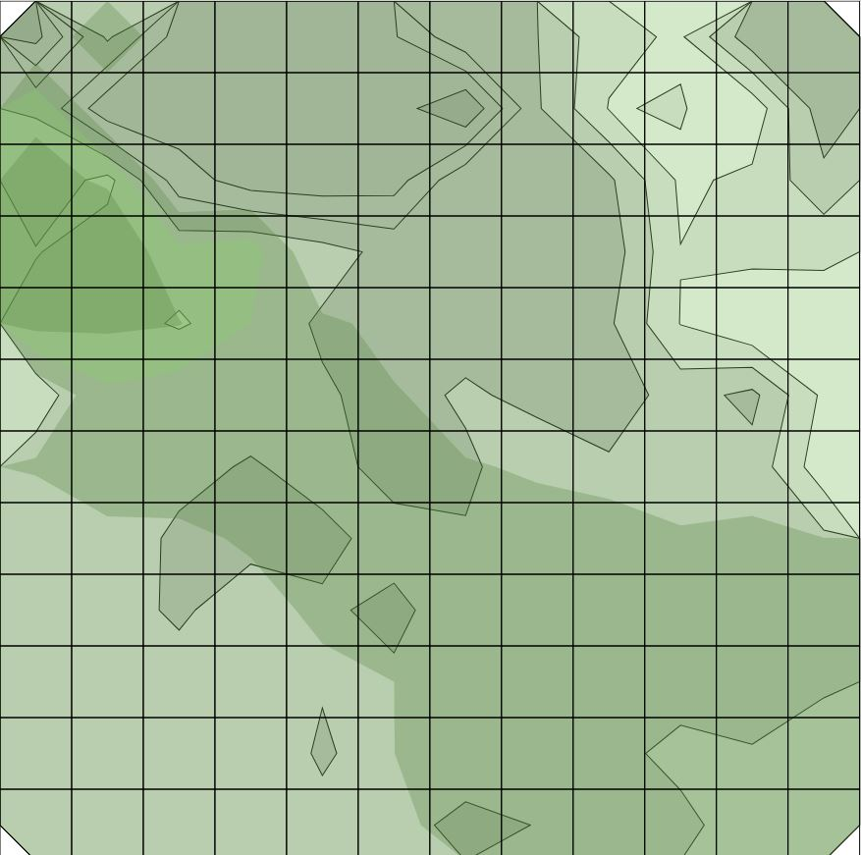
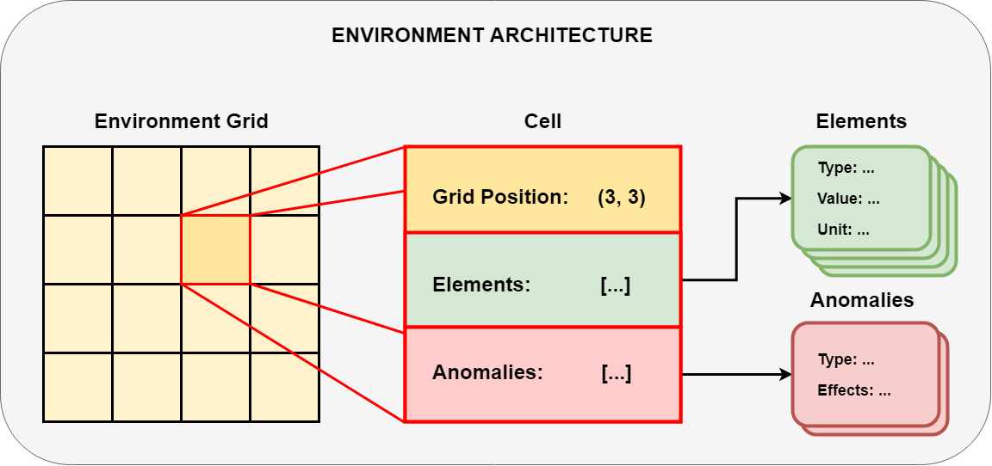
Environments
Cell grid
Element Types
Elevation
Temperature
Anomalies
Human

Slide 13
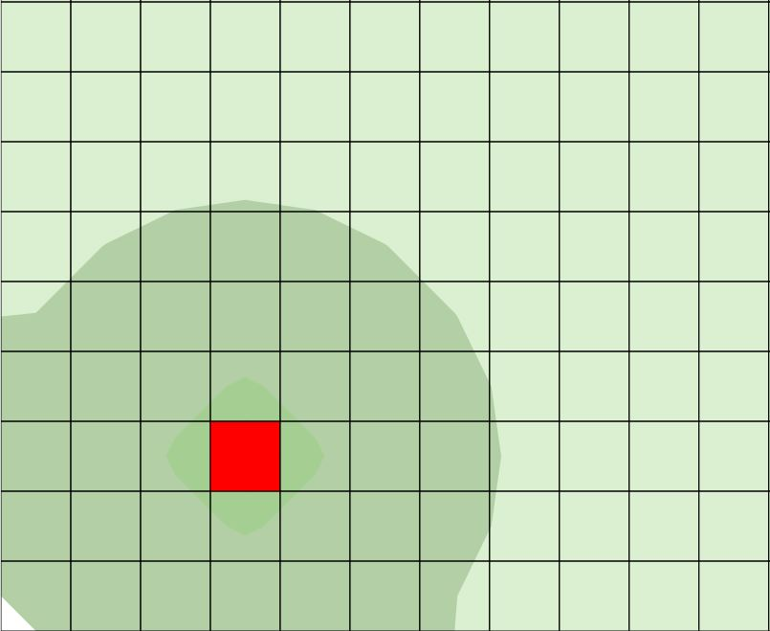
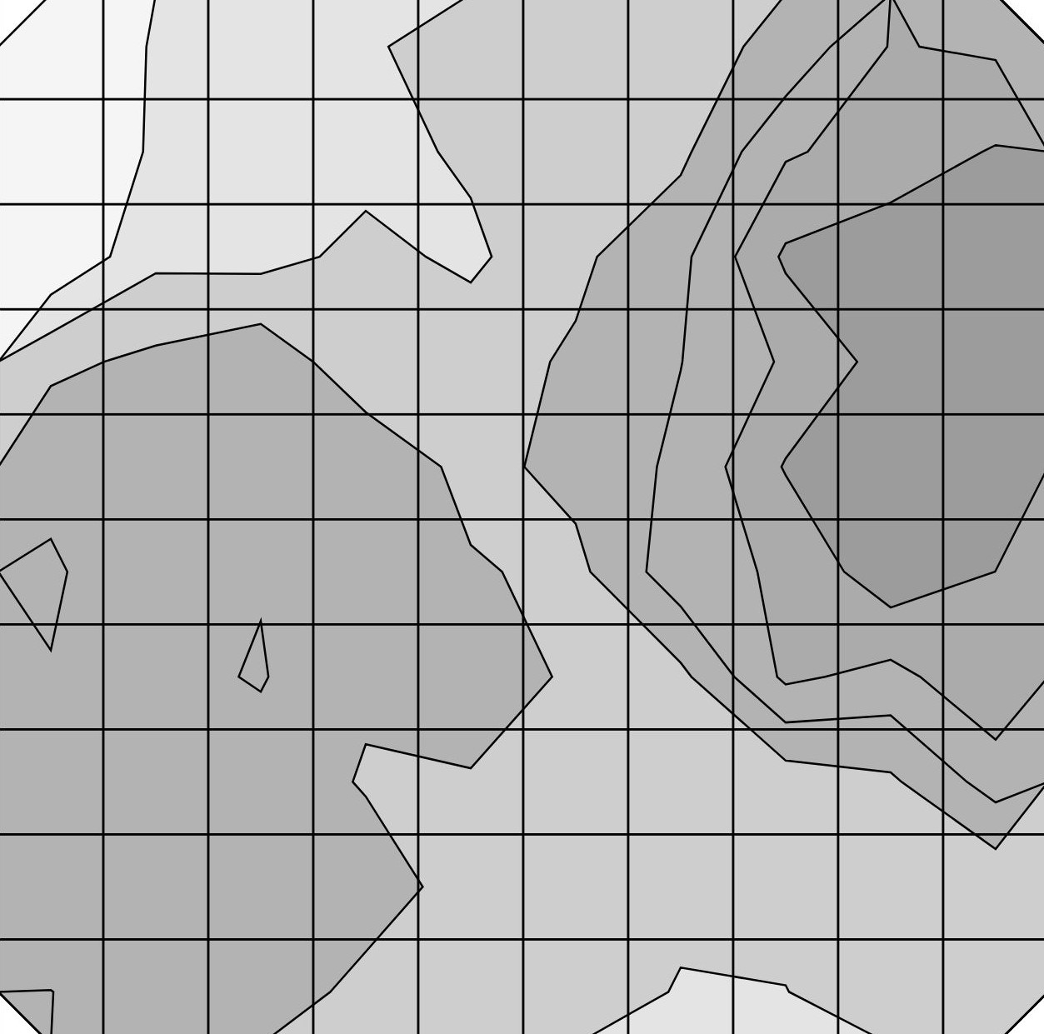
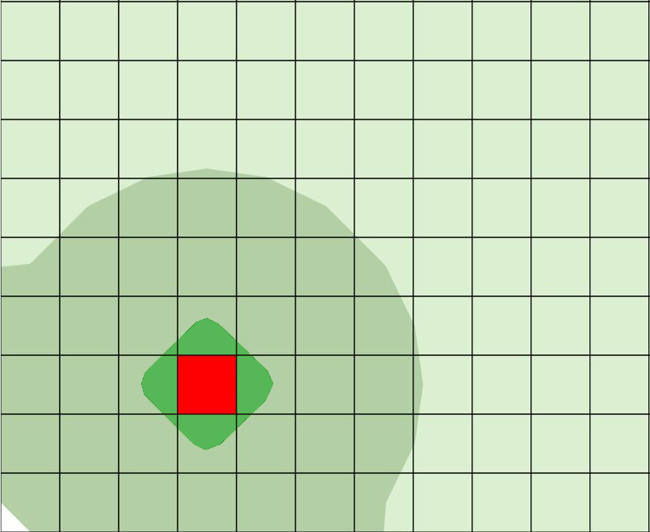
Procedurally Generated Environments
Environment Templates
Element types
Terrain modifications
Anomaly placement
Effects on area
Elevation
Anomaly Sound Effect

Slide 14
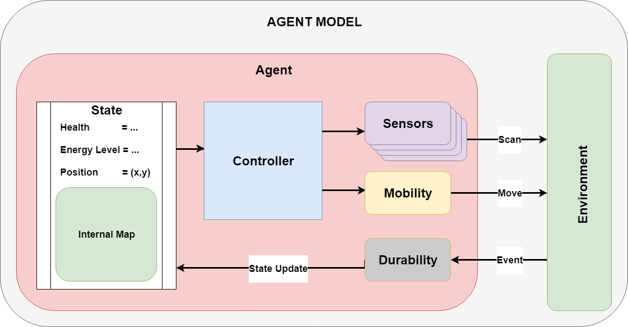
Agent Setup
Health & Energy
Internal Map
Controller
Mobility limitations
Durability to element types
Sensors

Slide 15
Agent Goals
Exploration-based objectives
Two main categories
Anomaly searching (Find Human)
Element mapping (Map Water)

Slide 16
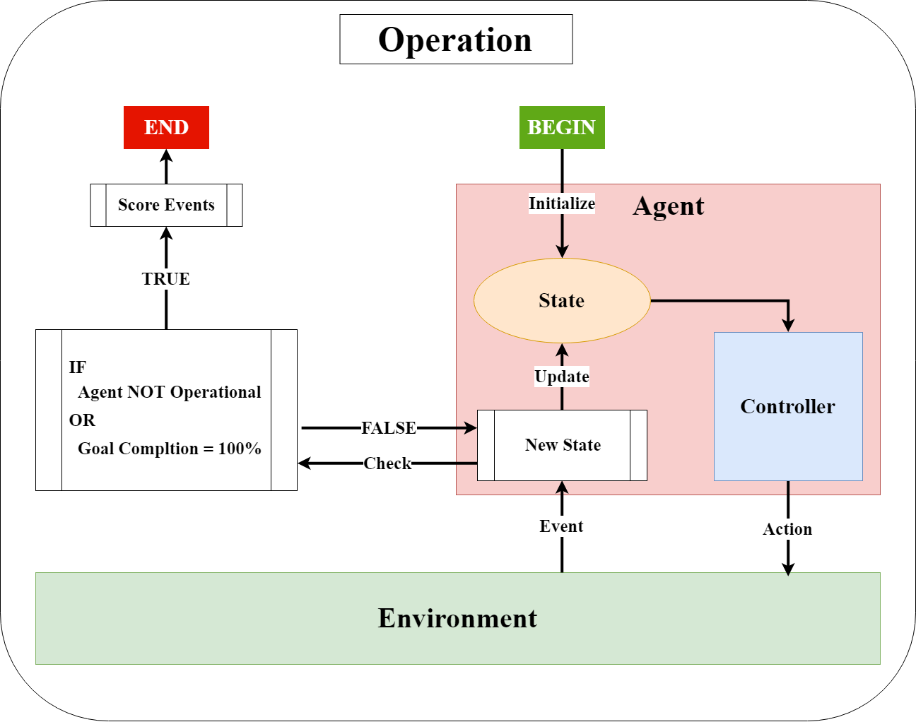
Operations
Agent
Navigate environment
Collect data
End Cases
Goal completed
Agent non-operational
Agent rewarded on how well it performs

Slide 17
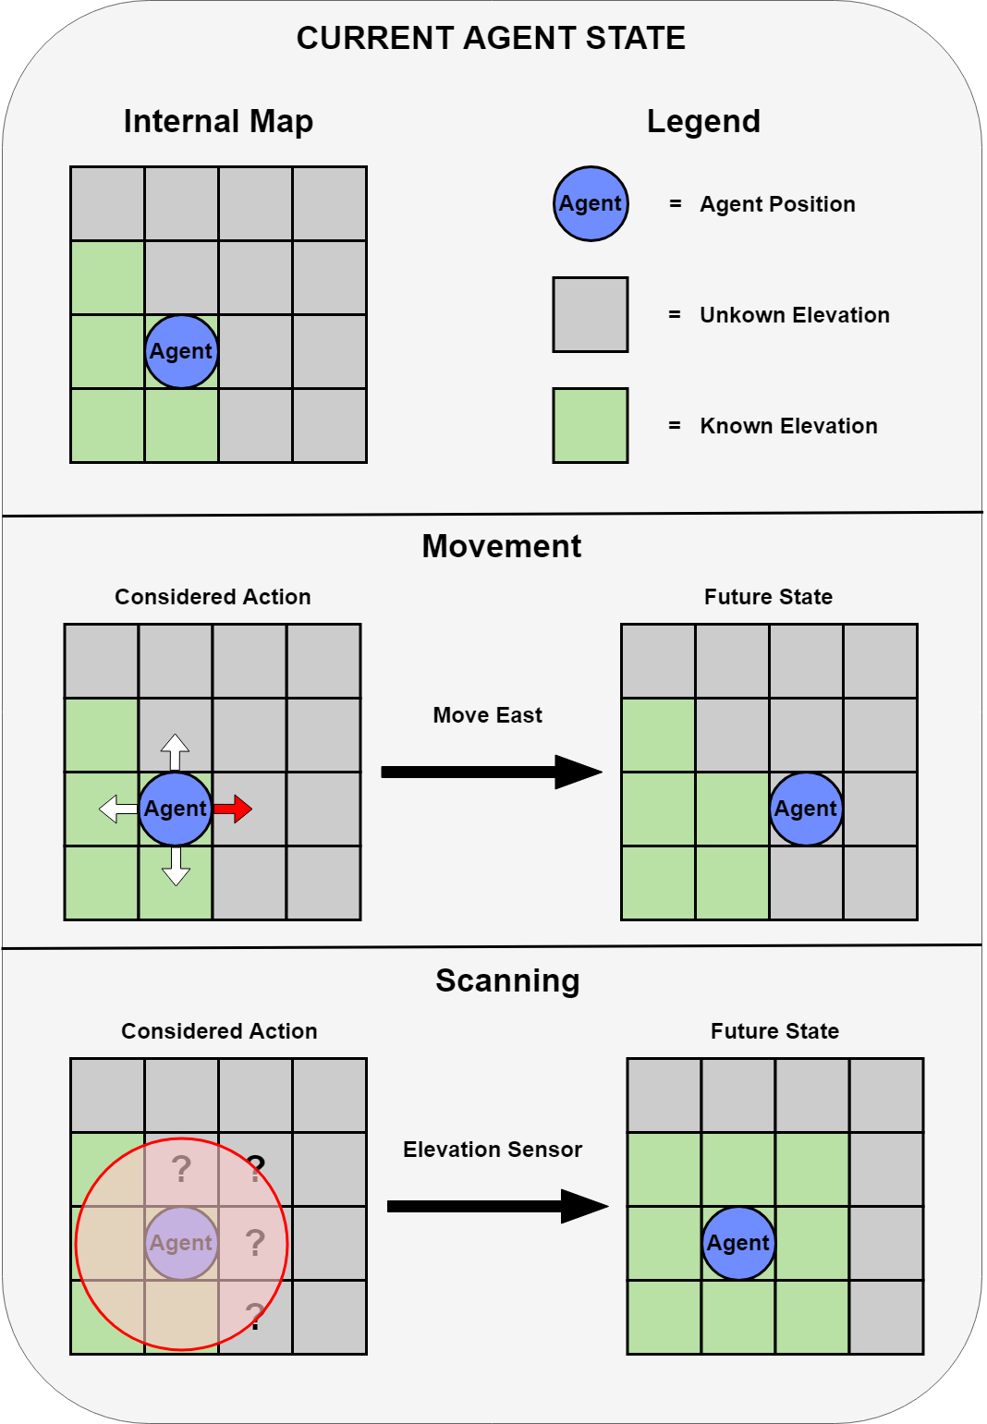
Agent Rewards
Short-Term
Movement
Scanning
Long-Term
Remaining health
Remaining energy
Goal completion
Notes:
We want to MAXIMIZE an agent’s rewards

Slide 18
Agent Controllers
Choose valid actions based on agent’s “state”
Controllers compared
Random
Heuristic
SCOUt
Notes:
Controllers are how we maximize rewards
BASE-LINES

Slide 19
Random Controller
Selects valid actions at random
No safe guards

Slide 20
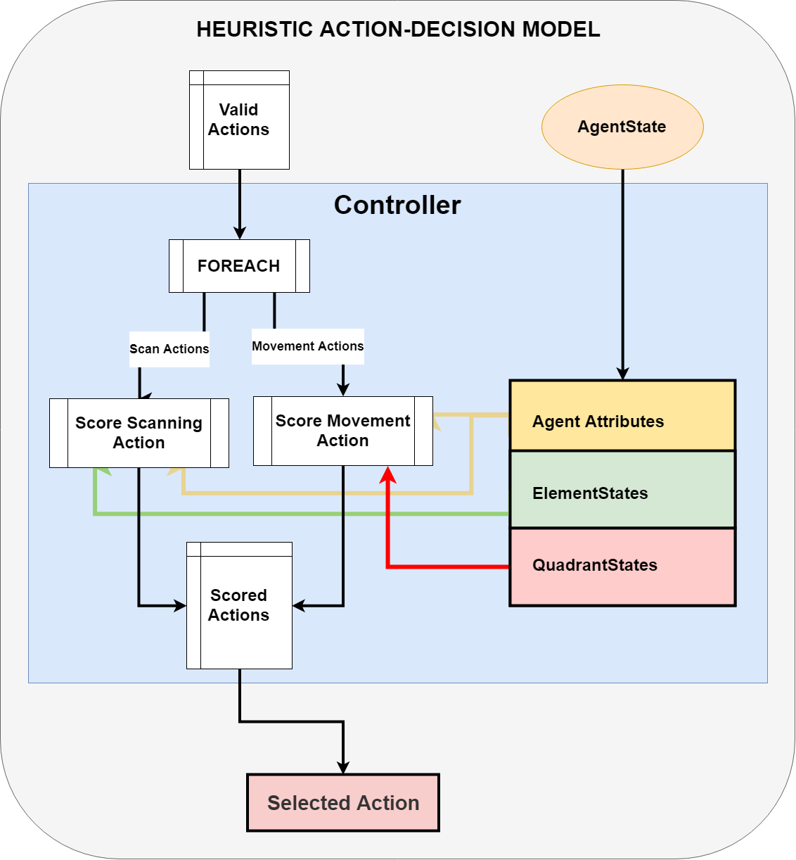
Heuristic Controllers
Logical analysis of state
Score each potential action
Designed for each goal
Good but not optimized
Notes:
Should beat random
Makes obvious decisions

Slide 21
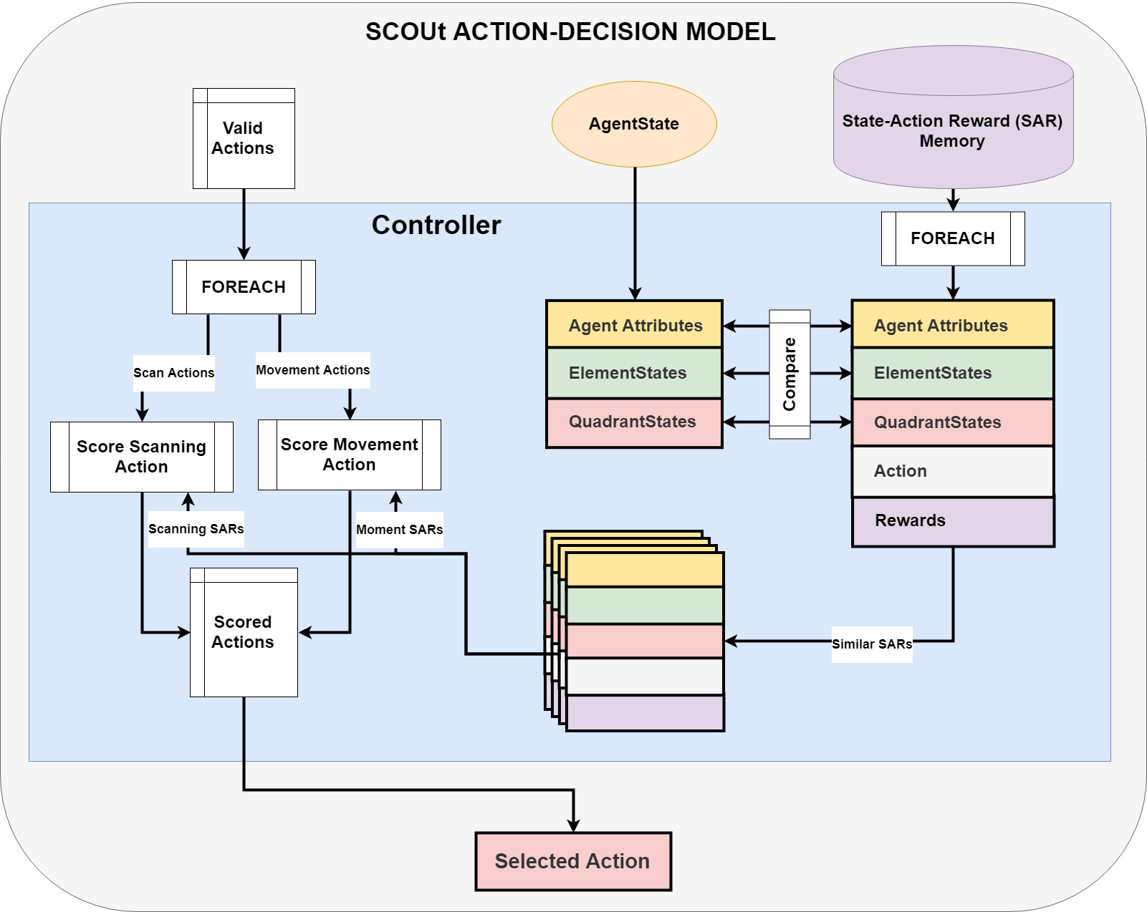
SCOUt controller
Retains memory of past operations
Compares current state to memory
Predicts future rewards
Adaptive to new goals
Notes:
Here’s how SCOUt differs

Slide 22
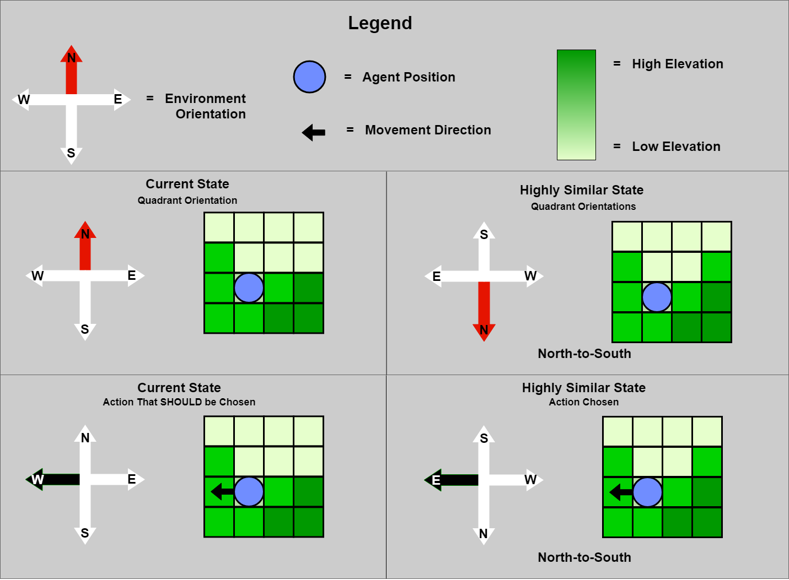
SCOUt Reward Prediction
Compare current state to memory
Score for each possible action
Average short-term reward
Average long-term reward
Confidence
How many similar states found
Average degree of similarity

Slide 23
Experiments
Agent Goals
Find Human
Map Water
Agent Setup
Environments
EASY (8x8)
MEDIUM (10x10)
HARD (12x12)
Train SCOUt controllers
SCOUt_{FH} – Find Human
SCOUt_{MW} – Map Water
SCOUt_{H} – Hybrid
Compare performances
Test adaptability
New goal
Different agent sensors
Additional training
Notes:
To see how well SCOUt is able to perform…

Slide 24
Performance Categories
Average Goal Completion
MAXIMIZE
Track usefulness
Average Remaining Health
MAXIMIZE
Track hazard avoidance
Average Number of Actions Taken
MINIMIZE
Track efficiency
Average Remaining Energy
MAXIMIZE
Track efficiency

Slide 25
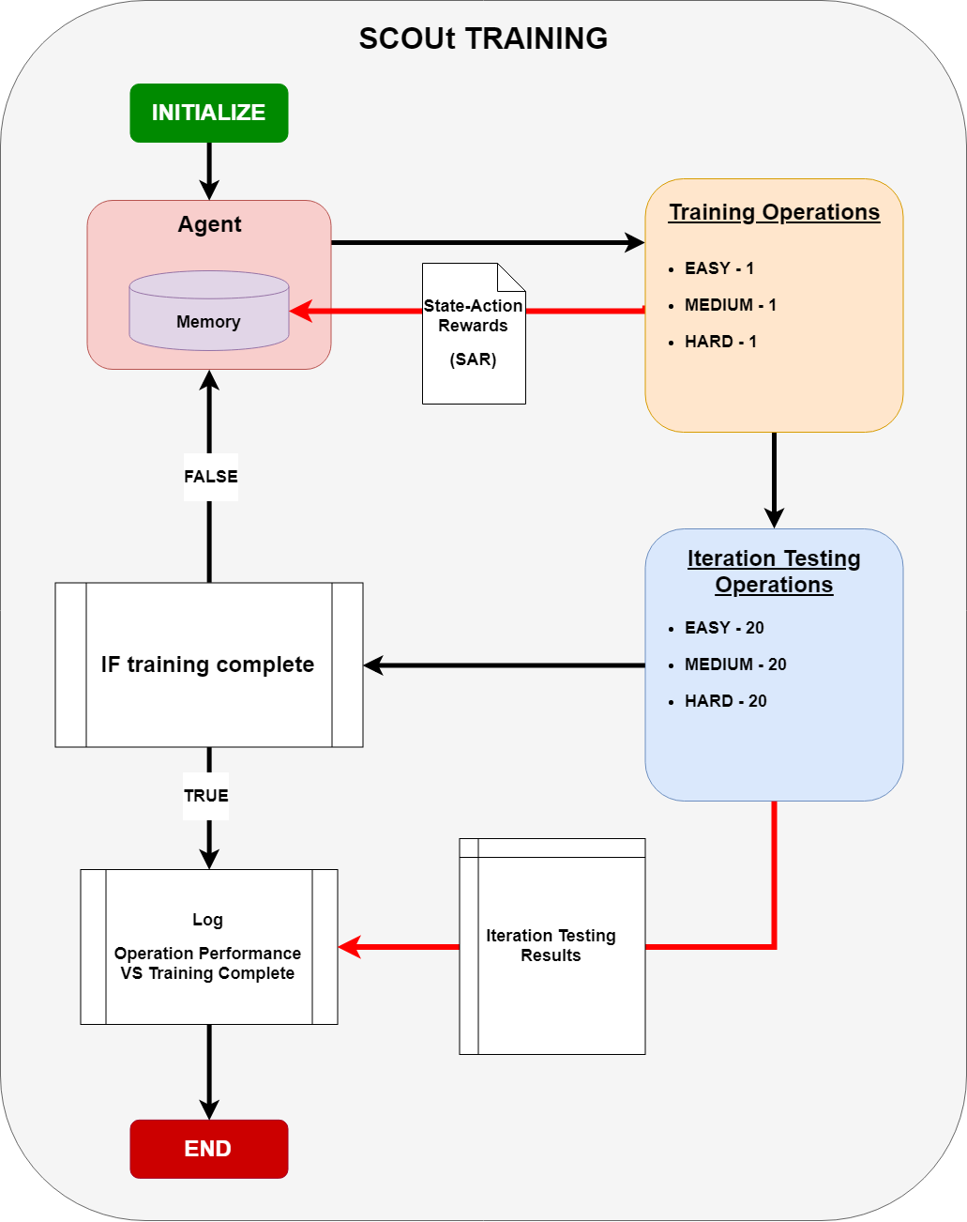
Training
30 iterations
Build up memory
Testing after each training set
Against Random controller
Notes:
Iteration Testing against RANDOM

Slide 26
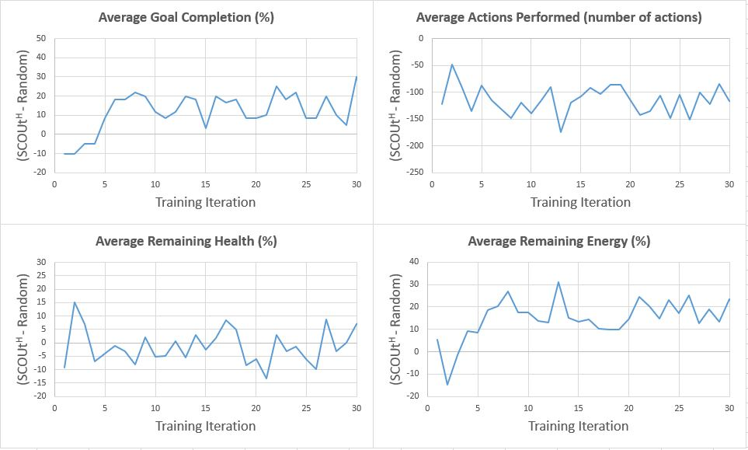
SCOUt – Find Human: Training Results

Slide 27
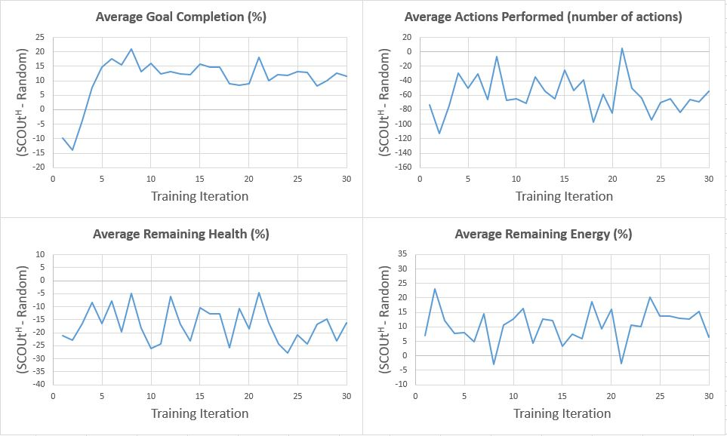
SCOUt – Map Water: Training Results

Slide 28
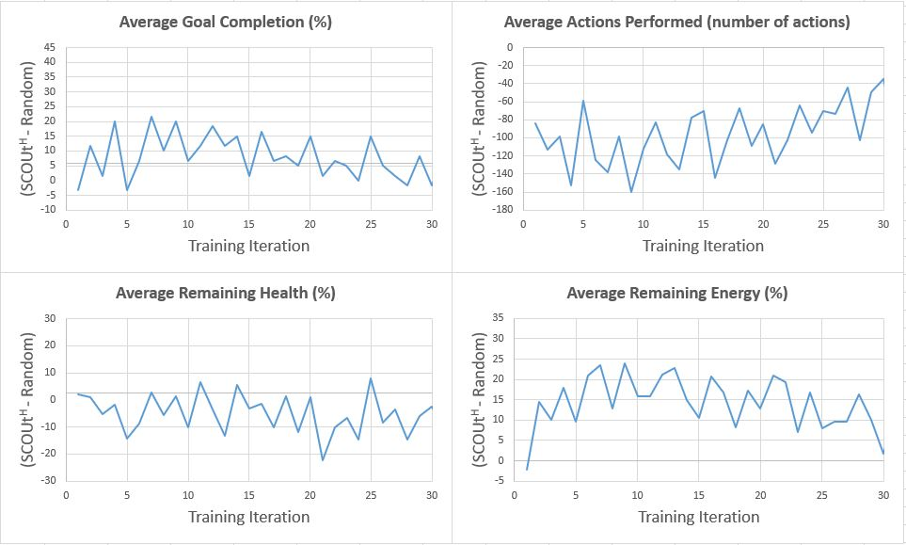
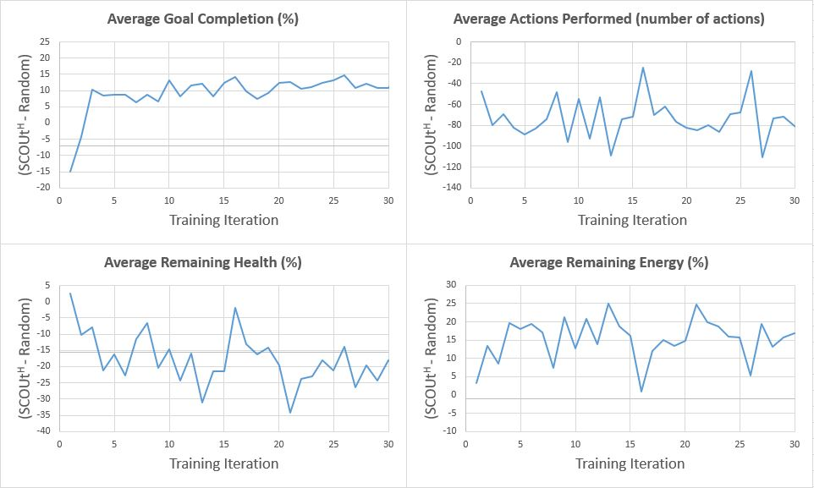
SCOUt – Hybrid: Training Results
Goal: Find Human
Goal: Map Water

Slide 29
Experiment 1
Compare each SCOUt controller to Heuristic and Random
1000 operations per environment difficulty
Respective goal (Hybrid tested twice)
What we expect to see
Random < Heuristic < SCOUt
Note: SCOUt is no longer training – does not retain memory of test operations

Slide 30
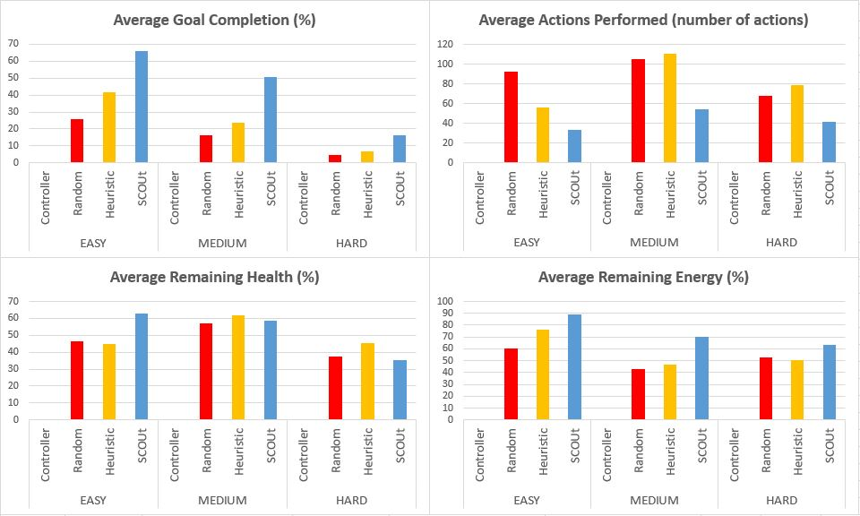
SCOUt – Find Human: Experiment 1 Results
Notes:
Controllers rank as expected
SCOUt takes majority lead

Slide 31
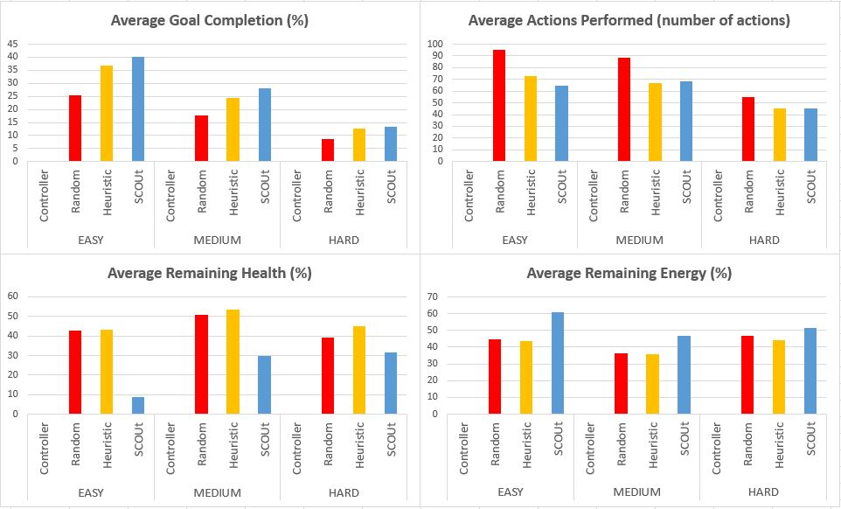
SCOUt – Map Water: Experiment 1 Results
Notes:
Controllers rank as expected
Overall goal completion is low
SCOUt suffers in remaining health

Slide 32
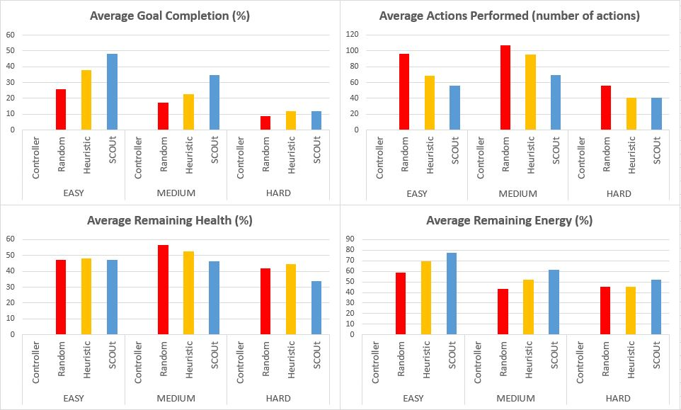
SCOUt – Hybrid: Experiment 1 Results (Find Human)
Notes:
Similar to SCOUt_{FH}
not as large of success margin

Slide 33
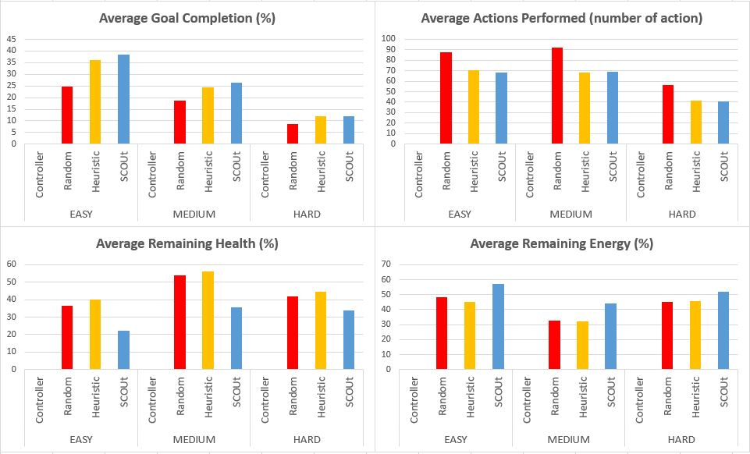
SCOUt – Hybrid: Experiment 1 Results (MAP WATER)
Notes:
Similar to SCOUt_{MW}
not as large of success margin

Slide 34
Experiment 2: Adaptability
Goal Change
SCOUt controllers tested on goal type with no training
Sensor Set Change
SCOUt controllers tested after removing sensors from agent
Additional training
SCOUt_{FH} retrained on Map Water
SCOUt_{MW} retrained on new Find Human
Retrained controllers tested
Notes:
RESULTS average all difficulty

Slide 35
Goal Change
Test SCOUt on goal it was not trained for
1000 operations per environment
Performance results averaged across all 3000 operations

Slide 36
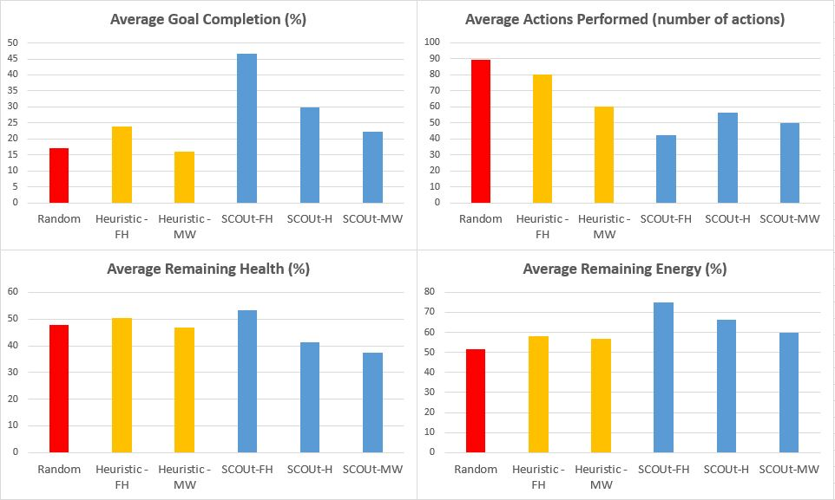
SCOUt – MAP WATER: Goal Change Results
Notes:
SCOUt_{MW} shows adaptability
Better than random
On par with heuristic

Slide 37
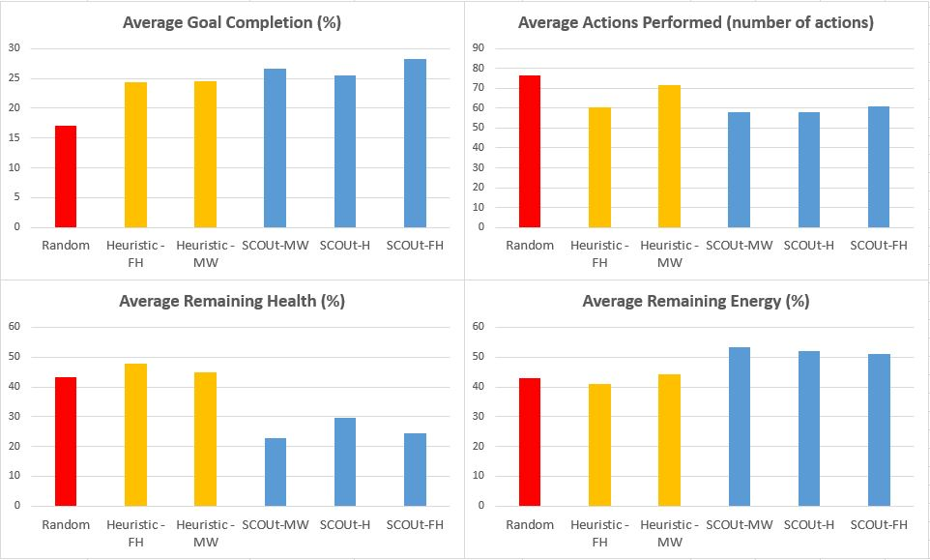
SCOUt – FIND HUMAN: Goal Change Results
Notes:
Unexpected Results
FH better goal completion than MW
Not quite as efficient though

Slide 38
Sensor Set Change
Test SCOUt after removing a sensor from the agent
1000 operations per environment
Performance results averaged across all 3000 operations

Slide 39
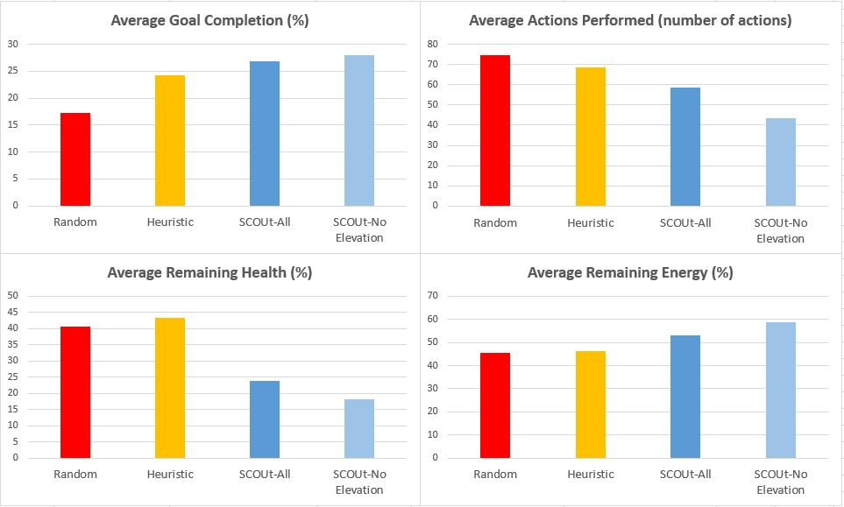
SCOUt – MAP WATER: Sensor Set Change Results

Slide 40
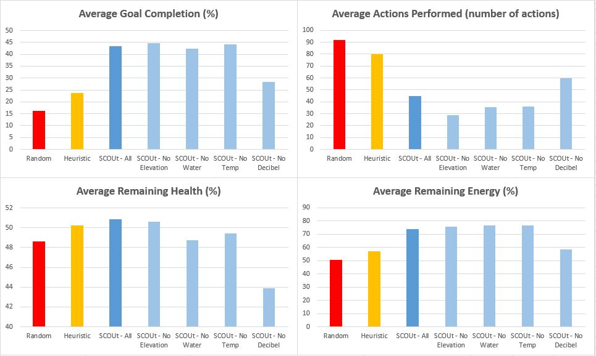
SCOUt – FIND HUMAN: Sensor set Change Results

Slide 41
Additional Training
Same training process
SCOUt_{FH+}
Starts with SCOUt_{FH} memory
Additional training on Map Water goal
SCOUt_{MW+}
Starts with SCOUt_{MW} memory
Additional training on Find Human goal

Slide 42
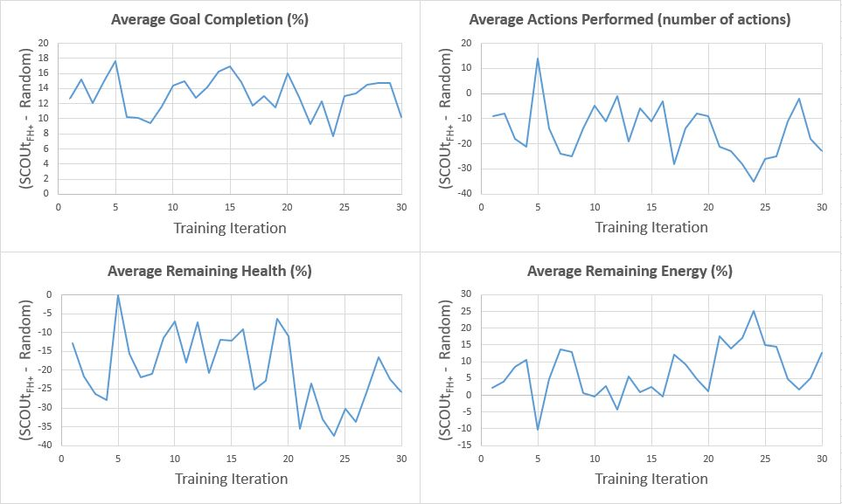
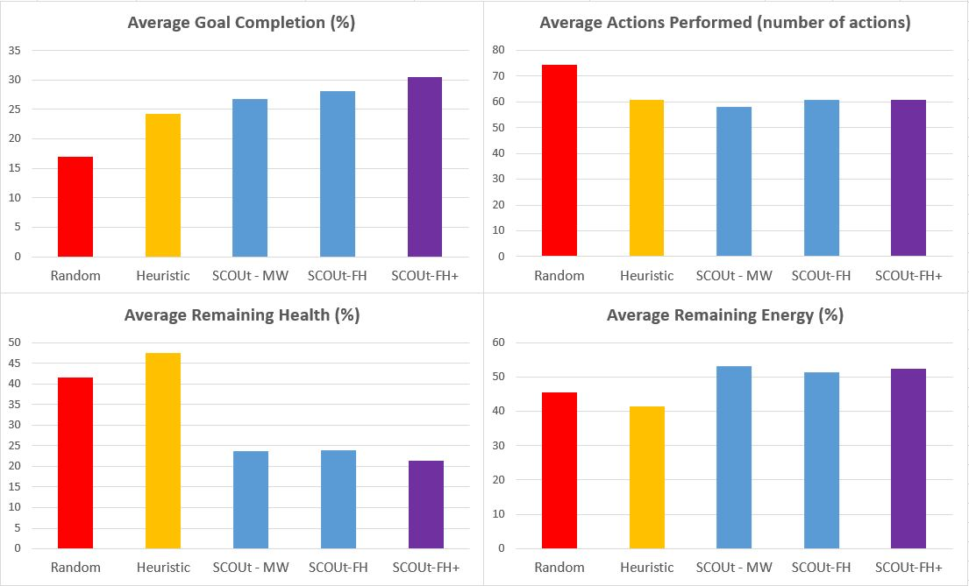
SCOUt – FIND HUMAN PLUS: Results

Slide 43
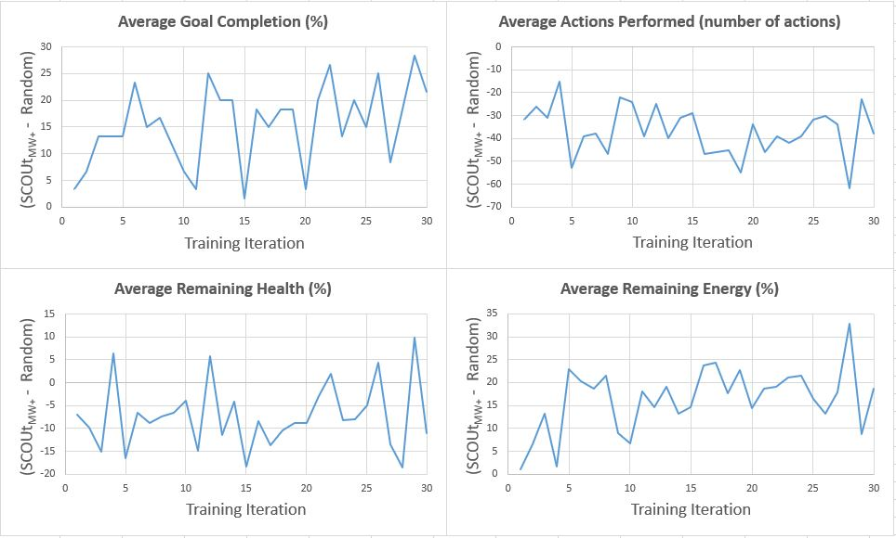
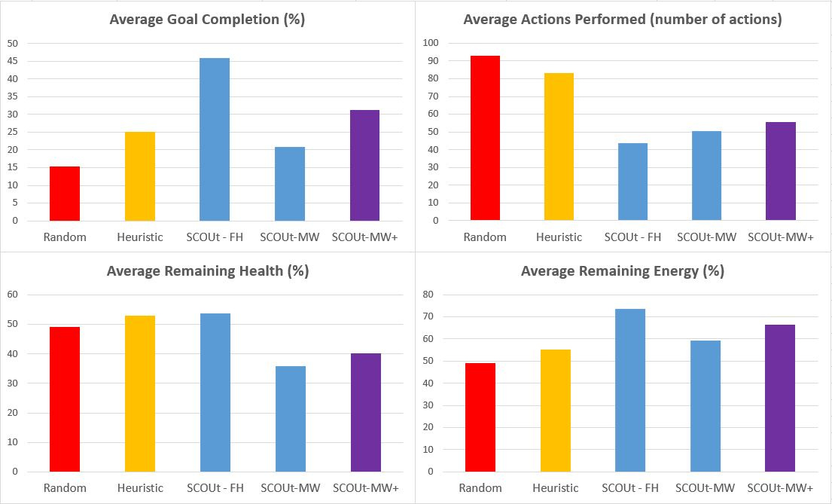
SCOUt – MAP WATER PLUS: Results

Slide 44
Conclusion
SCOUt shows adaptability
Performs well in both goal types
Presented to new goal
Sensors removed
Poor hazard avoidance behaviors
Promising results for generalizing controllers

Slide 45
Future Work
Adding behavior “rules”
Better memory management
Integration of goal to memory and comparisons

Slide 46
References
[1] Akash Arora, Robert Fitch, and Salah Sukkarieh. An Approach to Autonomous
Science by Modeling Geological Knowledge in a Bayesian Framework. 2017
IEEE/RSJ International Conference on Intelligent Robots and Systems (IROS),
pages 3803–3810, September 2017. arXiv: 1703.03146.
[2] Akash Arora, P. Michael Furlong, Robert Fitch, Terry Fong, Salah Sukkarieh,
and Richard Elphic. Online Multi-modal Learning and Adaptive Informative
Trajectory Planning for Autonomous Exploration. In Marco Hutter and Roland
Siegwart, editors, Field and Service Robotics, volume 5, pages 239–254. Springer
International Publishing, Cham, 2018.
[3] Kai Arulkumaran, Marc Peter Deisenroth, Miles Brundage, and Anil Anthony
Bharath. A Brief Survey of Deep Reinforcement Learning. IEEE Signal Processing
Magazine, 34(6):26–38, November 2017. arXiv: 1708.05866.
[4] Shi Bai, Fanfei Chen, and Brendan Englot. Toward autonomous mapping and exploration
for mobile robots through deep supervised learning. In 2017 IEEE/RSJ
International Conference on Intelligent Robots and Systems (IROS), pages 2379–
2384, Vancouver, BC, September 2017. IEEE.
[5] Mike Bostock. Data-Driven Documents.
[6] Travis Brown. circe.
[7] A. J. Clark. Evolving adabot: A mobile robot with adjustable wheel extensions
In 2017 IEEE Symposium Series on Computational Intelligence (SSCI), pages
1–8, November 2017.
[8] Jonathan E. Clark, Daniel I. Goldman, Tao Chen, Robert J. Full, and Daniel E.
Koditschek. Toward a Dynamic Vertical Climbing Robot. 2006.
[9] Justin Clark and Rafael Fierro. Mobile robotic sensors for perimeter detection
and tracking. ISA Transactions, 46(1):3–13, February 2007.
[10] Jonathon Doran and Ian Parberry. Controlled Procedural Terrain Generation
Using Software Agents. IEEE Transactions on Computational Intelligence and
AI in Games, 2(2):111–119, June 2010.
[11] Wolfgang Fink, James M. Dohm, Mark A. Tarbell, Trent M. Hare, Victor R.
Baker, Dirk Schulze-Makuch, Roberto Furfaro, Alberto G. Fairen, Ty P.A. Ferre,
Hideaki Miyamoto, Goro Komatsu, and William C. Mahaney. Tier-Scalable
Reconnaissance Missions For The Autonomous Exploration Of Planetary Bodies.
In 2007 IEEE Aerospace Conference, pages 1–10, Big Sky, MT, USA, 2007. IEEE.
[12] Zhiwei Fu, Bruce L. Golden, Shreevardhan Lele, S. Raghavan, and Edward A.
Wasil. A Genetic Algorithm-Based Approach for Building Accurate Decision
Trees. INFORMS Journal on Computing, 15(1):3–22, February 2003.
[13] Duncan W. Haldane, Kevin C. Peterson, Fernando Garcia Bermudez, and
Ronald S. Fearing. Animal-inspired design and aerodynamic stabilization of
a hexapedal millirobot. 2013 IEEE International Conference on Robotics and
Automation, pages 3279–3286, 2013.

Slide 47
References (cont.)
[14] Aaron M. Hoover, Samuel Burden, Xiao-Yu Fu, S. Shankar Sastry, and Ronald S.
Fearing. Bio-inspired design and dynamic maneuverability of a minimally actuated six-legged robot. 2010 3rd IEEE RAS & EMBS International Conference
on Biomedical Robotics and Biomechatronics, pages 869–876, 2010.
[15] James K. Hopkins, Brent W. Spranklin, and Satyandra K. Gupta. A survey of
snake-inspired robot designs. Bioinspiration & biomimetics, 4(2):021001, 2009.
[16] Bahare Kiumarsi, Kyriakos G. Vamvoudakis, Hamidreza Modares, and Frank L.
Lewis. Optimal and Autonomous Control Using Reinforcement Learning: A Survey.
IEEE Transactions on Neural Networks and Learning Systems, 29(6):2042–
2062, June 2018.
[17] Alex Kossett and Nikolaos Papanikolopoulos. A robust miniature robot design
for land/air hybrid locomotion. 2011 IEEE International Conference on Robotics
and Automation, pages 4595–4600, 2011.
[18] Stella Latscha, Michael Kofron, Anthony Stroffolino, Lauren Davis, Gabrielle
Merritt, Matthew Piccoli, and Mark Yim. Design of a Hybrid Exploration
Robot for Air and Land Deployment (H.E.R.A.L.D) for urban search and rescue
applications. 2014 IEEE/RSJ International Conference on Intelligent Robots
and Systems, pages 1868–1873, 2014.
[19] Steven M. LaValle. Planning Algorithms. Cambridge University Press, Cambridge,
2006.
[20] By James McCaffrey and 01/15/2014. How To Standardize Data for Neural
Networks -.
[21] npm, Inc. node-fetch.
[22] npm, Inc. Node Package Manager.
[23] Open-Scource Software. Babel.
[24] Open-Scource Software. webpack.
[25] Open-Source Software. Electron.
[26] Open-Source Software. http4s.
[27] Daniel Perea Ström, Igor Bogoslavskyi, and Cyrill Stachniss. Robust exploration
and homing for autonomous robots. Robotics and Autonomous Systems, 90:125–
135, April 2017.
[28] David L. Poole and Alan K. Mackworth. Artificial intelligence: foundations of
computational agents. Cambridge University Press, New York, 2010.
[29] Anthony R Cassandra. A survey of POMDP applications. Working Notes of
AAAI 1998 Fall Symposium on Planning with Partially Observable Markov Decision
Processes, January 1998.

Slide 48
References (cont.)
[30] Mac Schwager, Philip Dames, Daniela Rus, and Vijay Kumar. A Multi-robot
Control Policy for Information Gathering in the Presence of Unknown Hazards.
In Henrik I. Christensen and Oussama Khatib, editors, Robotics Research, volume
100, pages 455–472. Springer International Publishing, Cham, 2017.
[31] Guy Shani, Joelle Pineau, and Robert Kaplow. A survey of point-based POMDP
solvers. Autonomous Agents and Multi-Agent Systems, 27(1):1–51, July 2013.
[32] Olivier Sigaud and Stewart W. Wilson. Learning classifier systems: a survey.
Soft Computing, 11(11):1065–1078, September 2007.
[33] Lauren M. Smith, Roger D. Quinn, Kyle A. Johnson, and William R. Tuck. The
Tri-Wheel: A novel wheel-leg mobility concept. 2015 IEEE/RSJ International
Conference on Intelligent Robots and Systems (IROS), pages 4146–4152, 2015.
[34] C. Stachniss, D. Hahnel, and W. Burgard. Exploration with active loop-closing
for FastSLAM. In 2004 IEEE/RSJ International Conference on Intelligent Robots
and Systems (IROS) (IEEE Cat. No.04CH37566), volume 2, pages 1505–1510,
Sendai, Japan, 2004. IEEE.
[35] Richard S. Sutton and Andrew G. Barto. Reinforcement learning: an introduction.
Adaptive computation and machine learning. MIT Press, Cambridge, Mass, 1998.
[36] Lei Tai, Shaohua Li, and Ming Liu. Autonomous exploration of mobile robots
through deep neural networks. International Journal of Advanced Robotic Systems,
14(4):172988141770357, July 2017.
[37] The jQuery Foundation. jQuery.
[38] Li Yi and Kang Wanli. A New Genetic Programming Algorithm for Building
Decision Tree. Procedia Engineering, 15:3658–3662, 2011.

Slide 49
Acknowledgements

Slide 50
QUESTIONS

